Slide 1
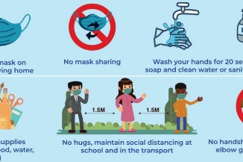
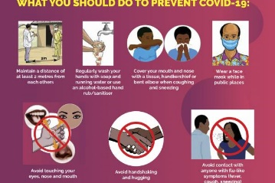

CORONAVIRUS DISEASE CORONAVRUS DISEASE (COVID-9) IS AN IFECTIOUS DISEASEBCAUSED BY A NEWLY DISCOVERED CORONAVIRUS. MOST PEOPLE WHO FALL SICK WITH COVID-19 WILL EXPERIENCE MILD TO MODERATE SYMPTOMS ND RECOVER WITHOUT SPECIAL TRETMENT. WE KNOW THAT THE DISEASE IS CAUSED BY THE SARS-COV-2 VIRUS, WHICH SPREADS BETWEEN PEOPLE IN SEVERAL DIFFERENT WAYS. THE VIRUS CAN SPREAD FROM AN INFECTED PERSON’S MOUTH OR NOSE IN SMALL LIQUID PARTICLES WHEN THEY COUGH, SNEEZE, SPEAK, SING OR BREATHE. THESE PARTICLES RANGE FROM LARGER RESPIRATORY DROPLETS TO SMALLER AEROSOLS. CURRENT EVIDENCE SUGGESTS THAT THE VIRUS SPREADS MAINLY BETWEEN PEOPLE WHO ARE IN CLOSE CONTACT WITH 1 METRE (SHORT-RANGE). A PERSON CAN BE INFECTED WHEN AEROSOLS OR

Slide 2

DROPLET CONTAINING THE VIRUS ARE INHALED OR COME DIRECTLY INTO CONTACT WITH THE EYES, NOSE,OR MOUTH. THE VIRUS CAN ALSO SPREAD IN POORLY VENTILATED AND/ OR CROWDED INDOORS SETTINGS, WHERE PEOPLE TEND TO SPEND LONGER PERIODS OF TIME. THIS IS BECAUSE AEROSOLS REMAIN SUSPENDED IN THE AIR OR TRAVEL FARTHER THAN 1 METRE (LONG-RANGE). PEOPLE MAY ALSO BECOME INFECTED BY TOUCHING SURFACES THAT HAVE BEEN CONTAMINATED BY THE VIRUS WHEN TOUCHING THEIR EYES, NOSE OR MOUTH WITHOUT CLEANING THEIR HANDS. FURTHER RESEARCH IS ONGOING TO BETTER UNDERSTAND THE SPREAD OF THE VIRUS AND WHICH SITTINGS ARE MOST RISKY AND WHY. RESEARCH IS ALSO UNDER WAY TO STUDY VIRUS VARIANTS THAT ARE MORE TRANSMISSIBLE. WHEN DO INFECTED PEOPLE TRANSMIT THE VIRYS? WHETHER OR NOT THEY HAVE SYMPOMS, INFECTED PEOPLE CAN BE CONTAFIOUS AND THE VIRUS CAN SPREAD FROM THEM TO OTHER PEOPLE. LABORATORY DATA SIGGESTS THAT INFECTED PEOPLE APPEAR TO BE MOST INFECTIOUS JUST BEFORE THEY DEVELOP SYMTOMS (NAMELY 2 DAYS BEFORE THEY DEVELOP SYMPTOMS)AND EARLY IN THEIR ILLNESS.

Slide 3
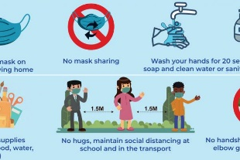
PEOPLE WHO DEVELOP SEVERE DISEASE CAN BE INFECTIOUS FOR LONGER. WHILE SOMEONE WHO NEVER DEVELOPS SYMPTOMS CAN PASS THE VIRUS TO OTHER, IT IS STILL NOT CLEAR HOW FREQUENTLY THIS OCCURS AND MORE RESEARCH IS NEEDED IN THIS AREA.WHAT IS THE DIFFERENCE BETWEEN PEOPLE WHO ARE ASYMPTOMATIC OR PRE-SYMPTOMATIC? DON’T THEY BOTH MEAN SOMEONE WITHOUT SYMPTOMS? BOTH TERMS REFER TO PEOPLE WHO DO NOT HAVE SYMPTOMS. THE DIFFERENCE IS THAT ‘ASYMPTOMATIC’ REFERS TO PEOPLE WHO ARE INFECTED BUT NEVER DEVELOP ANY SYMPTOMS, WHILE ‘PRE-SYMPTOMATIC’ REFERS TO INFECTED PEOPLE WHO HAVE NOT YET DEVELOPED SYMPTOMS BUT GO ON TO DEVELOP SYMPTOMS LATER. ARE THERE CERTAINSETTINGS WHERE COVID-19 CAN SPREAD MORE EASILY? YES, ANY SITUATION IN WHICH PEOPLE ARE IN CLOSE PROXIMITY TO ONE ANOTHER FOR LONG PERIODS OF TIME INCREASES THE RISK OF TRANSMISSION. INDOOR LOCATIONS, ESPECIALLY SETTINGS WHERE THERE IS POOR VENTIATION, ARE RISKIER THAN OUTDOOR LOCATIONS. ACTIVITIES WHERE MORE PARTICLES ARE EXPELLED FROM THE MOUTH, SUCH AS SINGING OR BREATHING HEAVILY DURING EXERCISE, ALSO INCREASE THE RISK OF TRANSMISSION.

Slide 4
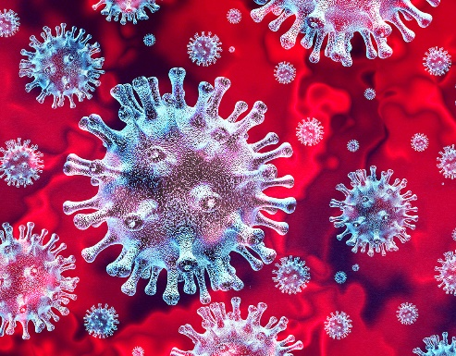

THE “THREE C’ S” ARE A USEFUL WAY TO THINK ABOUT THIS. THEY DESCRIBE SETTINGS WHERE TRANSMISSION OF THE COVID-19 VIRUS SPREADS MORE EASILY: CROWDED PLACES; CLOSE- CONTACT SETTINGS, ESPECIALLY WHERE PEOPLE HAVE CONVERSATIONS VERY NEAR EACH OTHER; CONFINED AND ENCLOSED SPACES WITH POOR VENTILATION. THE RISK OF COVID-19 SPREADING IS ESPECIALLY HIGH IN PLACES WHERE THESE “3CS” OVERLAP.IN HEALTH FACILITIES WHERE PEOPLE ARE RECEIVING TREATMENT FOR COVID-19, THERE IS AN INCREASED RISK OF INFECTION DURING MEDICA PROCEDURES CALLED AEROSOL GENERATING PRODURES. THESE CAN PRODUCE VERY SMALL DROPLETS THAT CAN STAY SUSPENDED IN THE AIR FOR LONGER PERIODS OF TIME AND SPREAD BEYOND CONVERSATIONAL DISTANCES (TYPICALLY 1 METER).

Slide 5
THIS IS WHY HEALTH WORKERS PERFORMING THESE PROCEDURES OR IN SETTINGS WHERE THESE PROCEDURES ARE PERFORMED SHOULD TAKE SPECIFIC AIRBORNE PROTECTION MEASURES, INCLUDNG USING APPROPRIATE PERSONAL PROTECTIVE EQUIPMENT SUCH AS RESPIRATORS. THIS IS ALSO WHY VISITORS ARE NOT PERMITTED I AREAS WHERE THESE PROCEDURES ARE BEING PERFORMED. HOW CAN I REDUCE MY RISK OF GETTING COVID-19? YHERE ARE MANY THINGS YOU CAN DO TO KEEP YOURSELF AND YOUR LOVED ONRS SAFE FROM COVID-19. KNOW YOUR RISKS TO LOWER RISKS. FOLLOW LOCAL GUIDANCE: CHECK TO SEE WHAT NATIONAL, REGIONAL AND LOCAL AUTHORITIES ARE ADVISIG SO YU HAVE THE MST RELEVANT INFORMATION FOR WHERE YOU ARE. KEEP YOU DISTANCE: STAY AT LEAST 1 METRE AWAY FROM OTHERS, EVEN IF THEY DON’T APPEAR TO BE SICK, SINCE PEOPLE CAN HAVE THE VIRUS WITHOUT HAVING SYMPTOMS. WEAR A MASK: WEAR A WELL-FITTING THREE-LAYER MASK, ESPECIALLY WHEN YOU CAN,T PHYSICALLY DISTANCE, OR IF YOU’RE INDOORS. CLEAN YOUR HANDS BEFORE PUTTING ON AND TAKING OFF A MASK. AVOID CROWDED PLACES, POORLY VENTILATED, INDOORS LOCATIONS AND AVOID PROLONGED CONTACT WITH OTHERS.

Slide 6
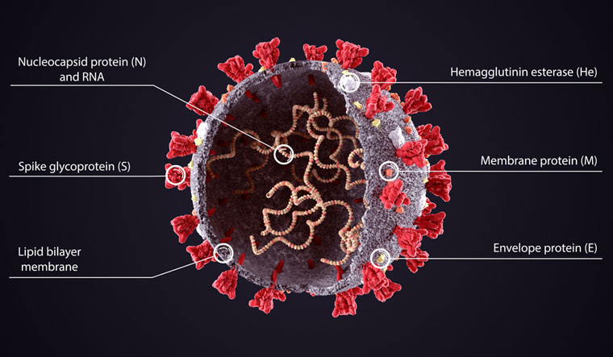
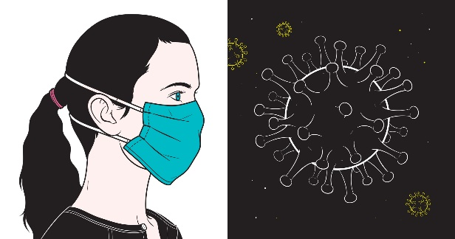

SPEND MORE TIME OUTDOORS THAN INDOORS. VENTILATION IS IMPORTANT: OPEN WINDOWS WHEN INDOORS TO INCREASE THE AMOUNT OF OUTDOO AIR. AVOID TOUCHING SURFACES, ASPECIALLY IN PUBLIC SETTINGS OR HEALTH FACILITIES, IN CASE PEOPLE INFECTED WITH COVID-19 HAVE TOUCHED THEM. CLEAN SURFACE REGULARLY WITH STANDARD DISINFECTANTS. FREQUENTLY CLEAN YOUR HANDS WITH SOAP AND WATER, OR AN ALCOHOL-BASED HAND HUB. IF YOU CAN, CARRY ALCOHOL-BASED RUB WITH YOU AND USE IT OFTEN. COVER YOUR COUGHS AND SNEEZES WITH A BENT ELBOW OR TISSUE, THROWING USED TISSUES INTO A CLOSED BIN RIGHT AWAY. THEN WASH YOUR HANDS OR USE AN ALCOHOL-BASED HAND RUB. GET VACCINATED: WHEN IT’S YOUR TURN, GET VACCINATED. FOLLOW LOCAL GUDANCE AND RECOMMENDATIONS ABOUT VACCINATION.

